Slide 1
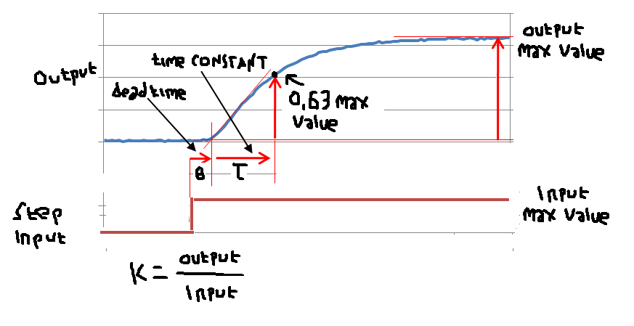
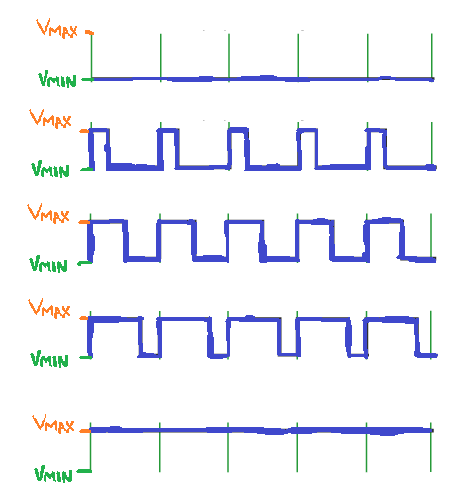
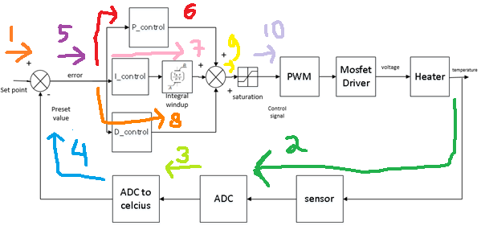

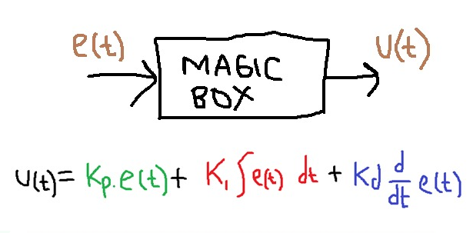
Cara kerja PID Control
Content :
Introduction
What is control system (Input vs output)
Open loop system vs close loop system
Example of open loop system
Example of close loop system
How PID Control works
Step by step PID Control explained (proteus simulation)
Speaker : Muhammad Husni, S. Pd
Python Programmer

Slide 2
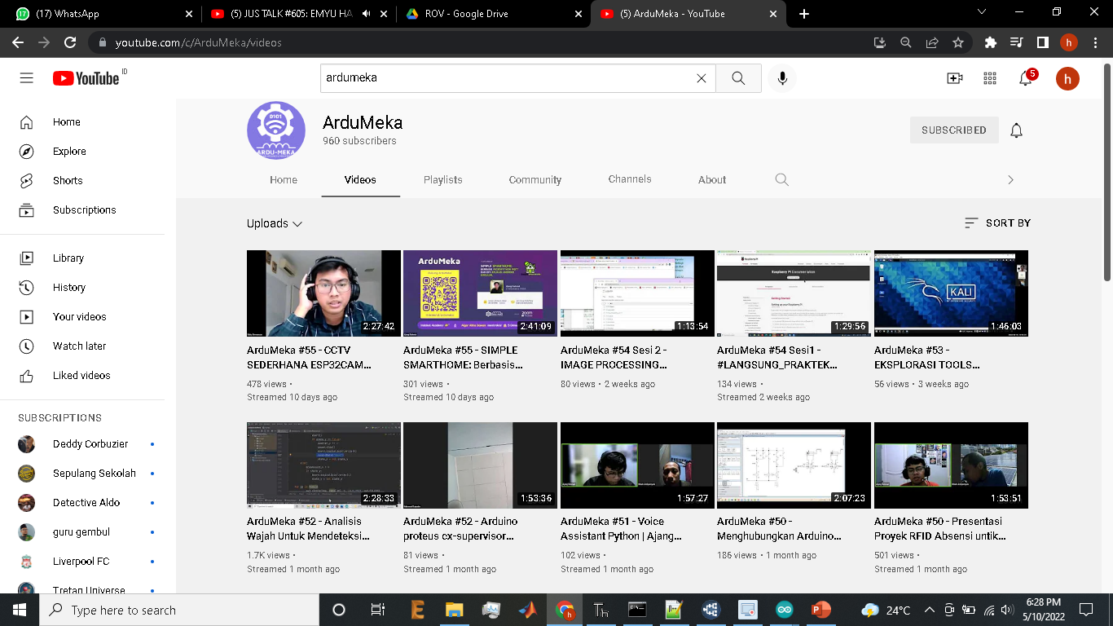

Slide 3
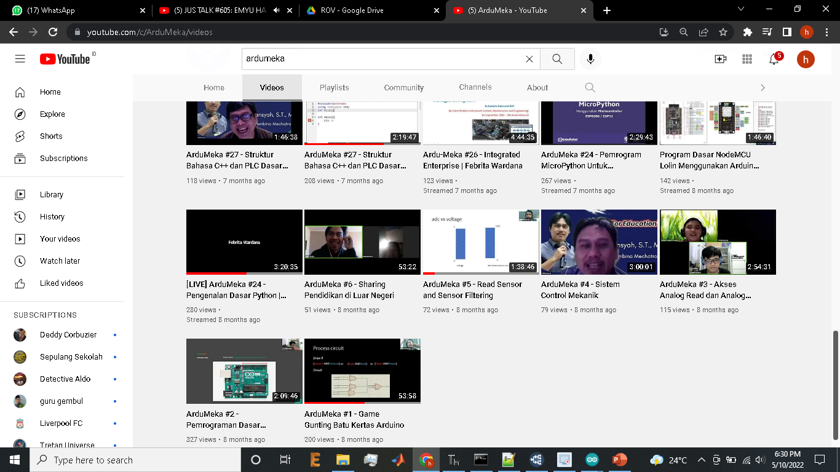

Slide 4
Timeline
19.30-21.00 : discussion

Slide 5
Name : Muhammad Husni Muttaqin, S. Pd.
Birth date : 5 June 1998
Hometown : Bandung
Current Job : Python Programmer at PT Syergie Indoprima
Experiences : - 2019 : Dynamics Positioning System control system engineer on cable ship kalibaru – untung jawa 20Kv cable installation (PT Syergie Indoprima)
- 2019 : Dynamics Positioning System control system engineer on cable ship lampung – pahawang 20Kv cable installation (PT Syergie Indoprima)
- 2020 : Dynamics Positioning System control system engineer on cable ship palapa ring tengah cable maintenance (PT Syergie Indoprima)
- 2021 - 2022 : Electronics and control system engineer for Vent-I (PT Syergie Automa Teknologi)
-2022 : Lightning Arrester Analyzer (LAPI ITB and Petronas Carigali, Gresik)
- 2022 : Underwater ROV RnD Engineer (PT Syergie Indoprima)

Slide 6
My experience : DPS System
Propeller 4
Propeller 1
MQTT connection
Propeller 3
Propeller 2
My DPS System experiences:
Kalibaru – pulau seribu
LCT SJP186 – Lampung pahawang
LCT CHH – Palapa ring Tengah Ondong – Manado Km6 - Km12
Control room
Gps, wind sensor, dps gui interface
Main Propeller

Slide 7
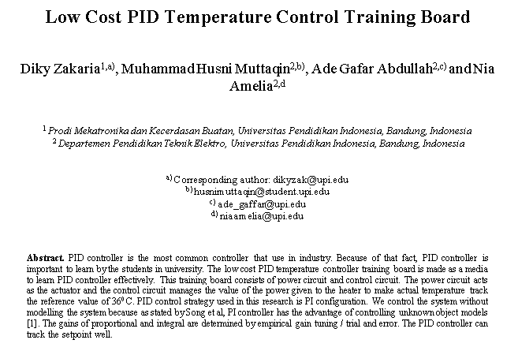
Based on real research story

Slide 9
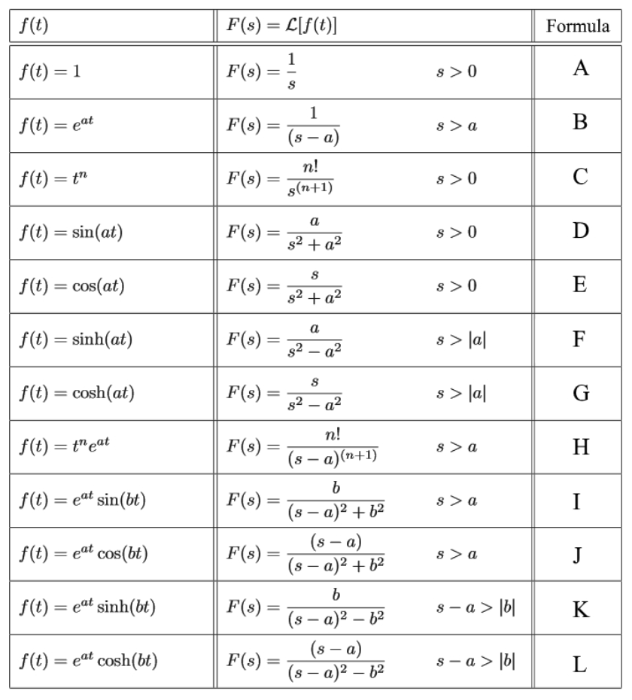
DISCLAIMERRRRR…..
….only practical example

Slide 10
DISCLAIMERRRRR…..
Goal of this content
Can make simple PID System in simulation

Slide 11
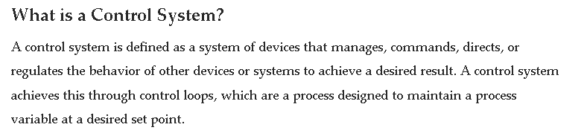
Introduction

Slide 12
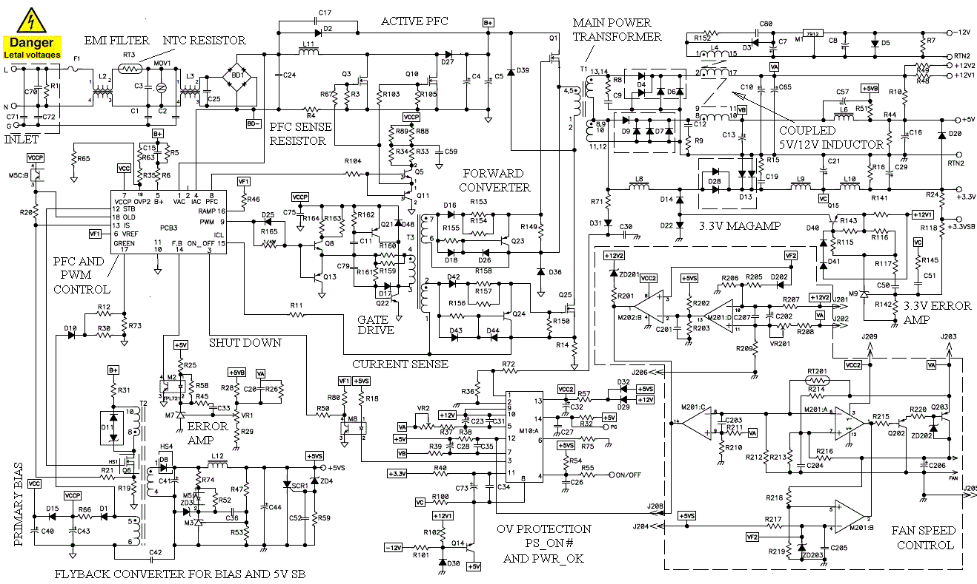

Slide 13
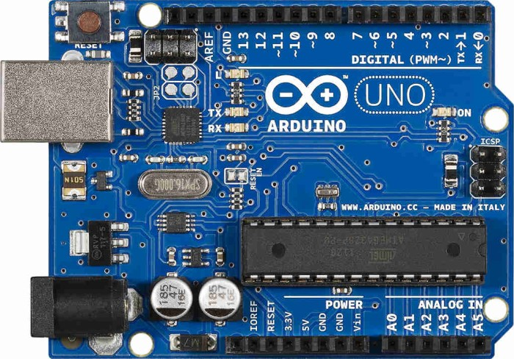
Life are much easier. Thanks to Arduino ☺

Slide 14
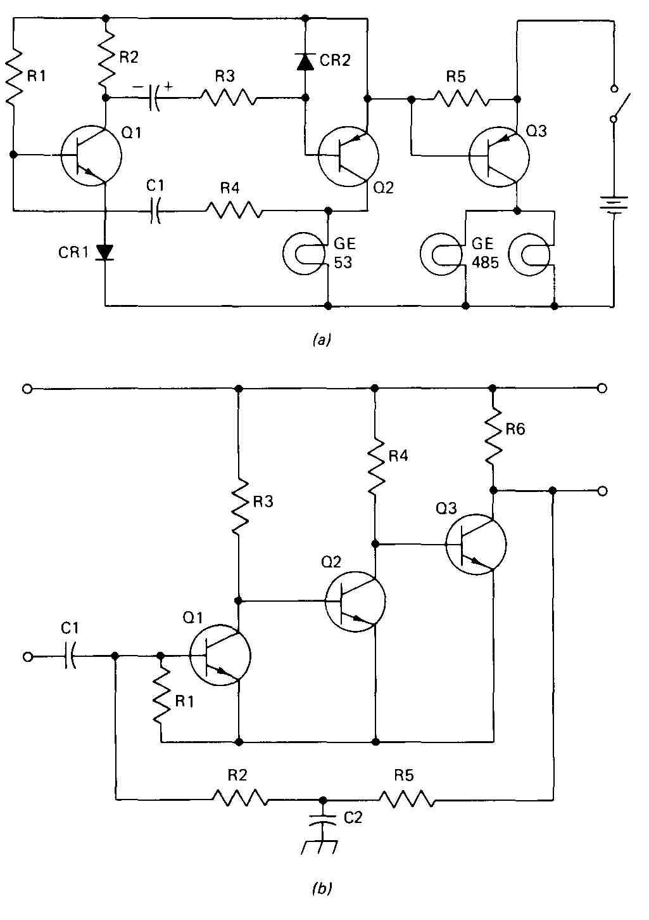
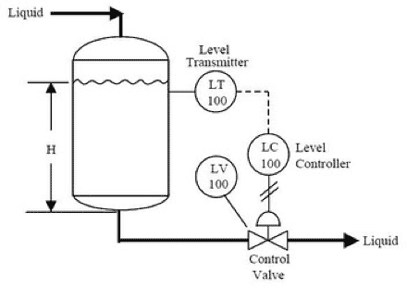
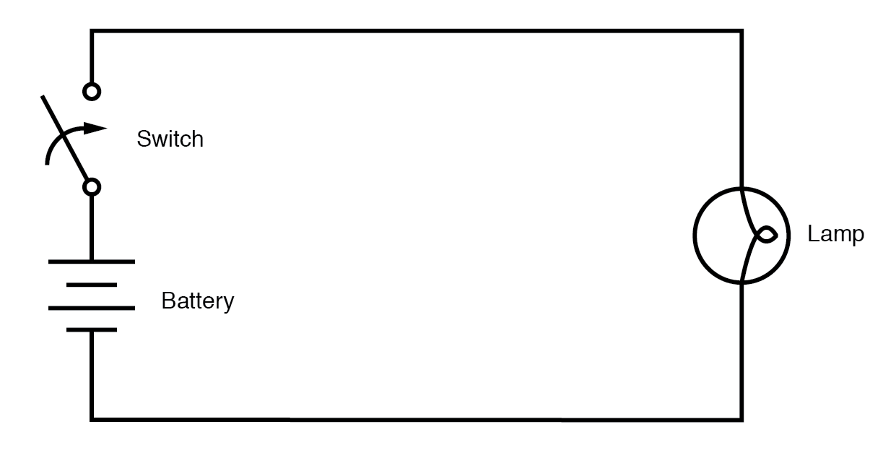
Introduction

Slide 15
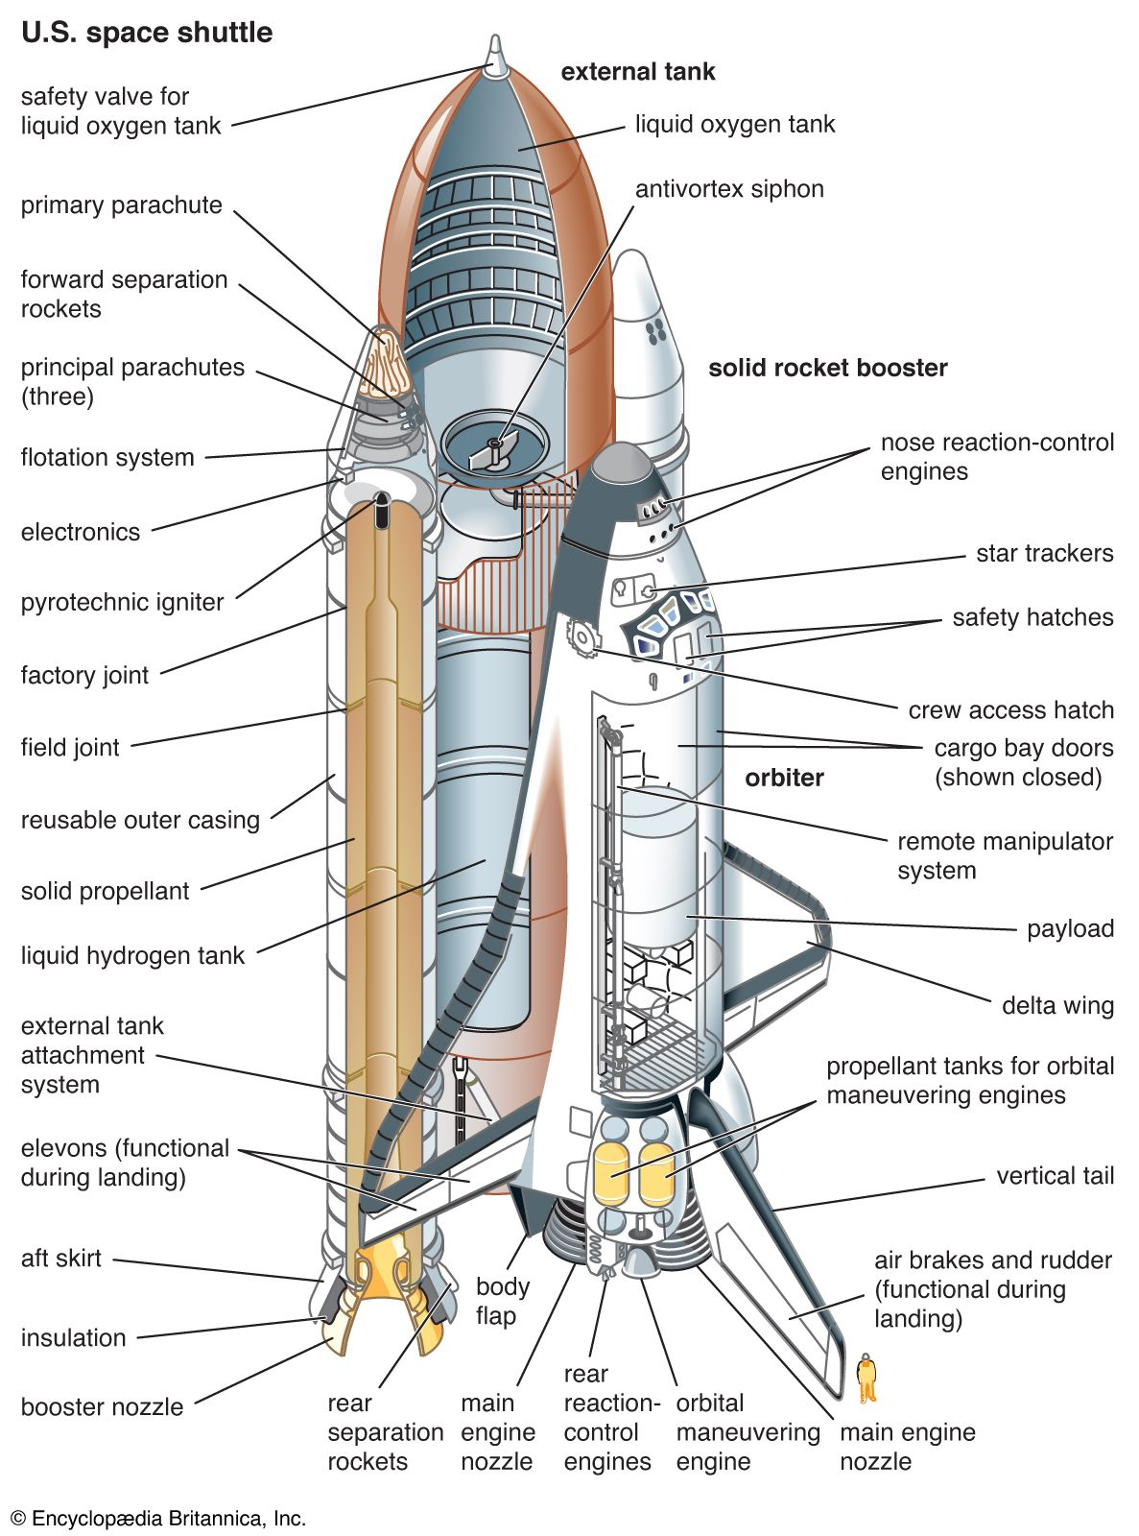
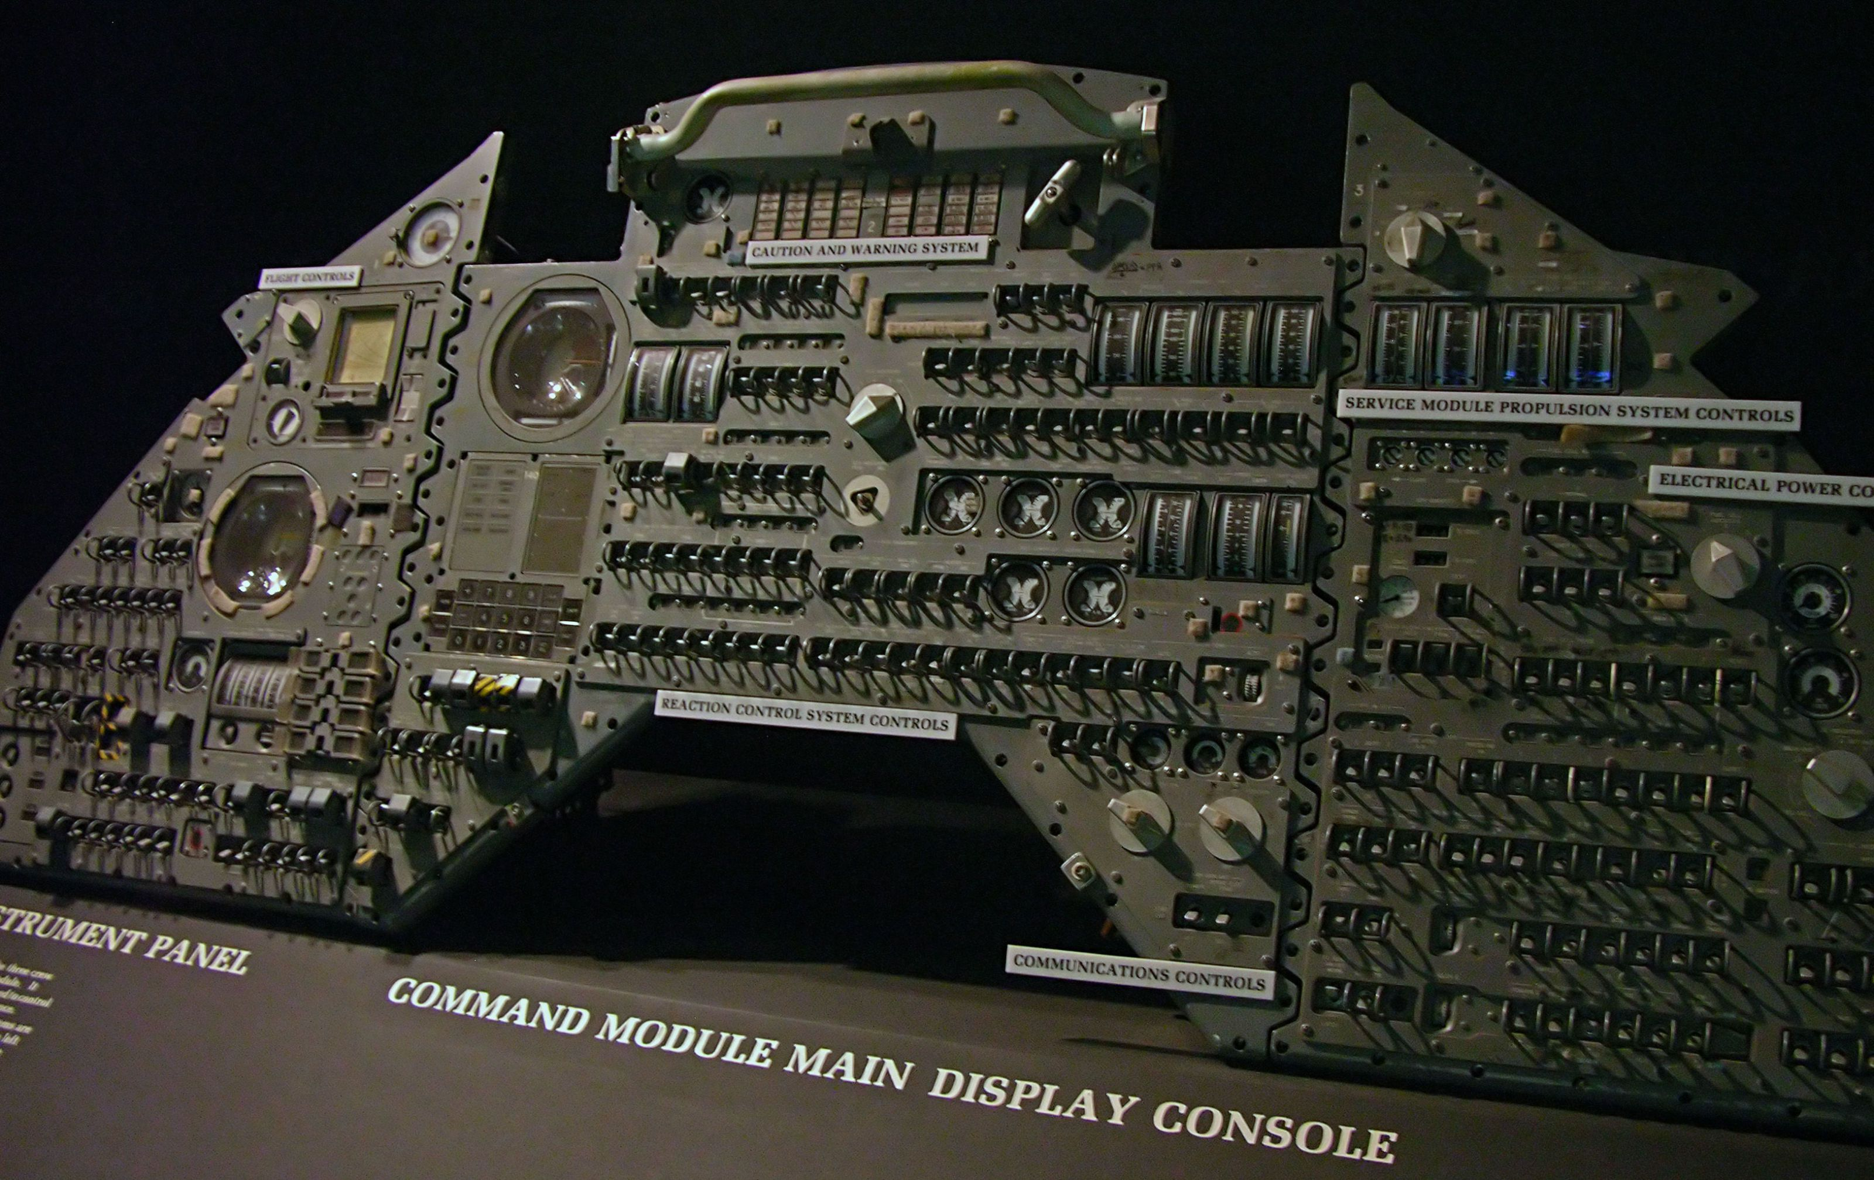
Introduction

Slide 16
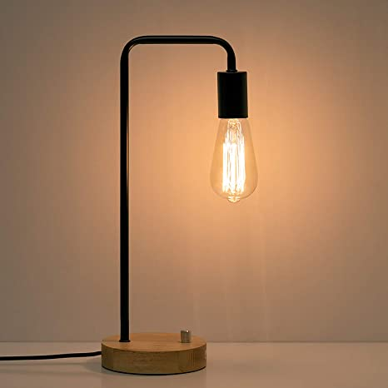
Input vs output

Slide 17
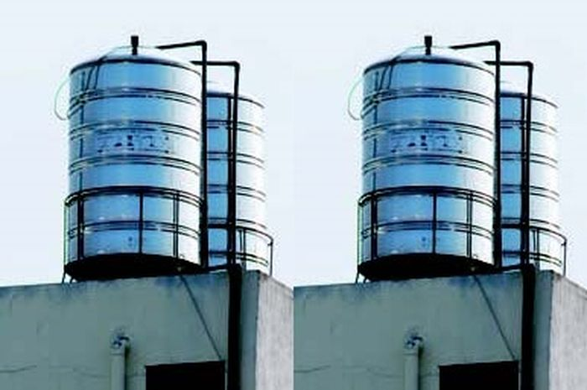
Input vs output

Slide 18
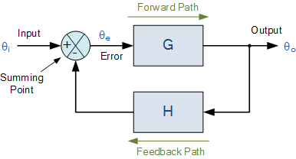
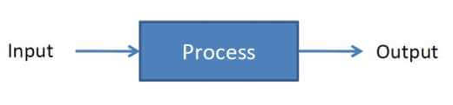
Open loop system vs close loop system

Slide 19

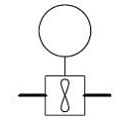
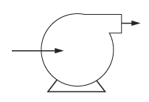
Example of open loop system
MINI GAME OPEN LOOP CONTROL 01

Slide 20
Example of close loop system
SHOWS PID WORKS

Slide 21
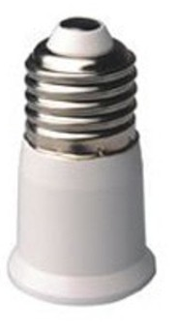
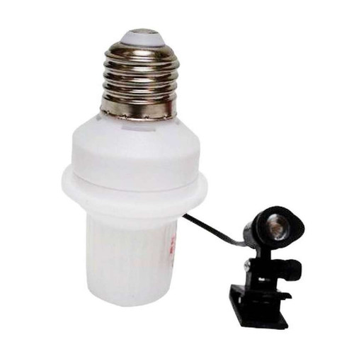
Summary of openloop vs closeloop

Slide 22
Close loop system
On – Off CONTROL
PID CONTROL

Slide 23
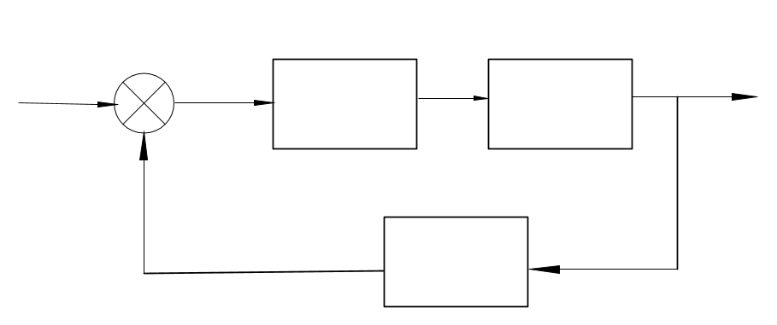
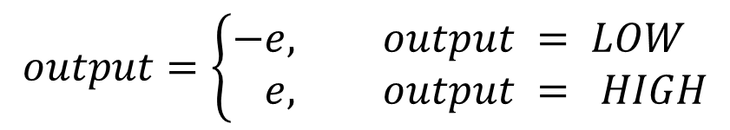
Close loop system
On-Off Control
output
setpoint
Error (e)
On off control
actuator
sensor
$$output=\left\{\begin{aligned}−e, &output = LOW \\ e, &output = HIGH\end{aligned}\right.$$

Slide 24
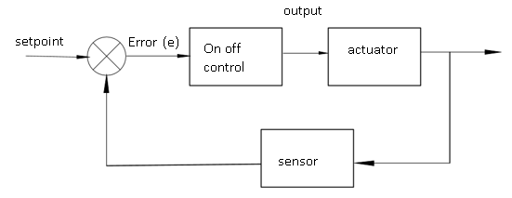
How to convert block diagram to code

Slide 25
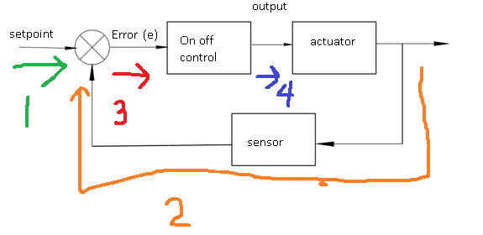
On – off control

Slide 26
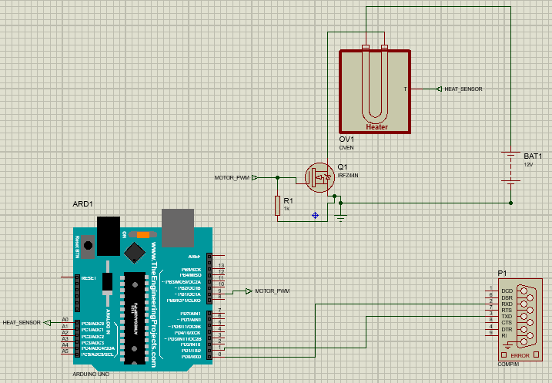

Slide 27
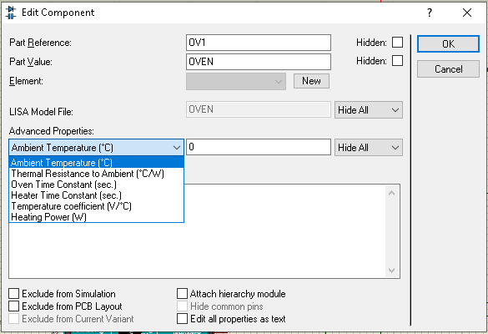
Heater parameter
Ambient temperature : 0
C/W : 1
Oven time constant : 3
Heater Time constant : 3
V/C : 0.08
W : 4

Slide 28
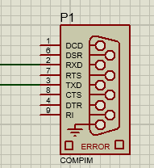
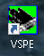
COMPIM

Slide 30
Close loop system
On-Off Control advantage :
- easy to implement
- easy to debug
-
-
-
On-off Control Weakness:
- hard to achieve stability
-
-

Slide 31
Close loop system
On-off Control Weakness:
- hard to achieve stability
Believe or not ??????
To solve this stability problem there are Improvement by using PID CONTROL

Slide 32
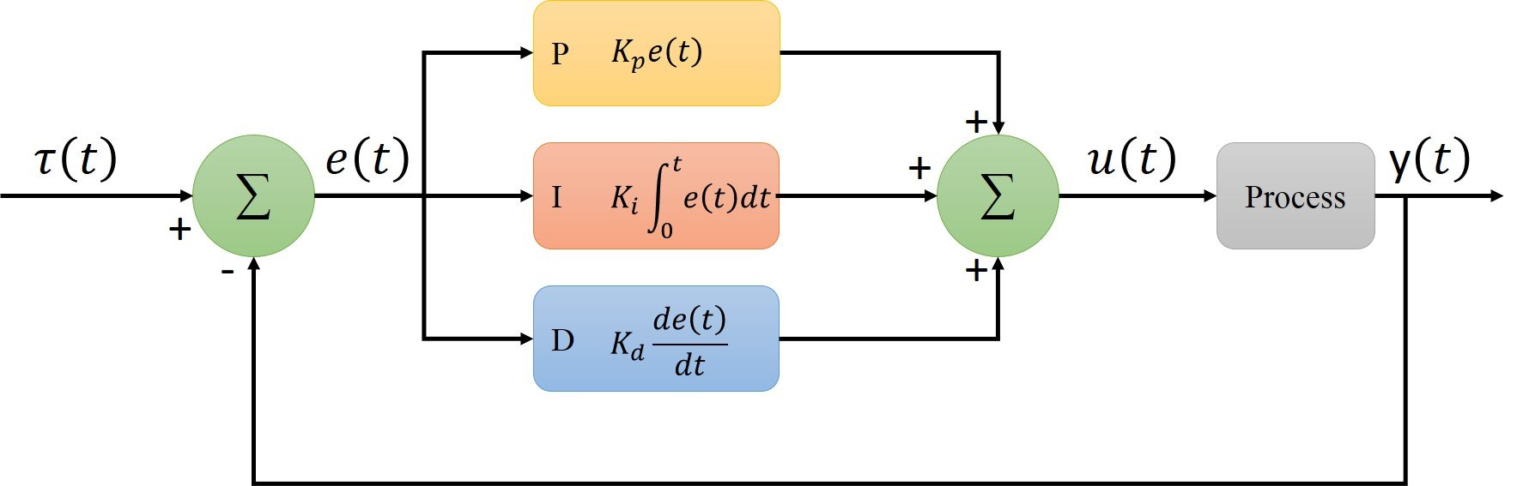
Close Loop Control

Slide 33
How PID Control works
Kp = ???????
Ki = ??????
Kd = ???????

Slide 34
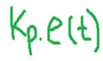
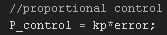
How PID Control works
Proportional control

Slide 35
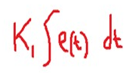
How PID Control works
Integral control

Slide 36
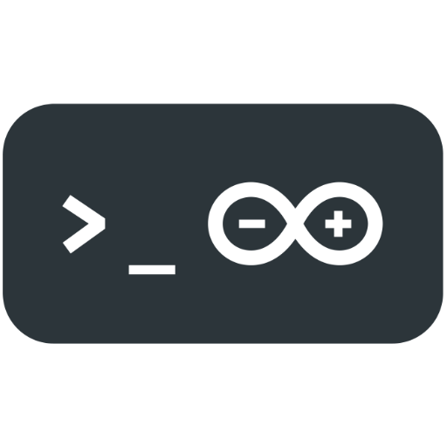

How PID Control works
Integral control
OR
HOW……… ?????????

Slide 37
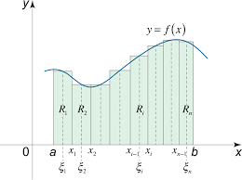
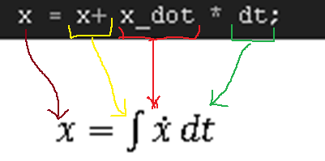
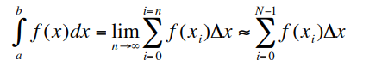
Riemann sum

Slide 38
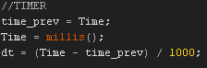
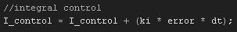
Soooo….

Slide 39
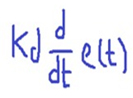
How PID Control works
Derivative control

Slide 40
How PID Control works
Derivative control
OR
HOW……… ?????????

Slide 41
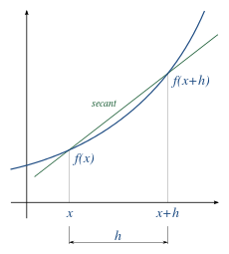
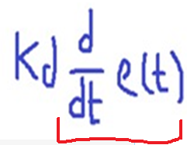
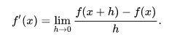
How PID Control works
Derivative control
“numerical derivation”
https://mathworld.wolfram.com/NumericalDifferentiation.html#:~:text=Numerical%20differentiation%20is%20the%20process,more%20difficult%20than%20numerical%20integration.

Slide 42
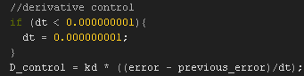
How PID Control works
Derivative control

Slide 43
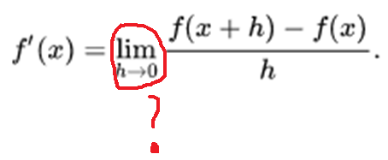
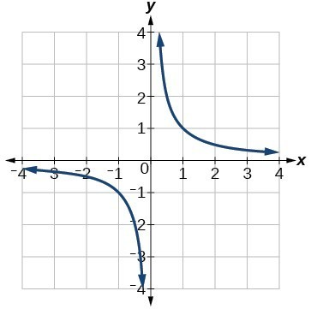

Slide 44
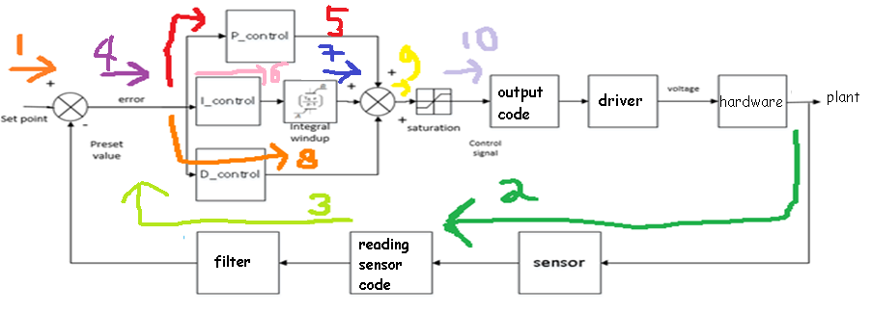
Step by step PID Control explained (proteus /tinkercad simulation)

Slide 45
Step by step PID Control explained (proteus /tinkercad simulation)
OR

Slide 47
If PID Tune Well

Slide 49

Step by step PID Control explained (proteus /tinkercad simulation)
1. Define setpoint
You can change this variable from potensiometer, keypad, and another way for example from IoT Connection

Slide 50


Step by step PID Control explained (proteus simulation)
2. Reading sensor (analogRead from heat sensor)

Slide 51


Real hardware PID control demonstration
3. Set sensor filter

Slide 52


Real hardware PID control demonstration
Note:
Revision from my research range value is 0-1.0
Source :https://www.megunolink.com/documentation/arduino-libraries/exponential-filter/

Slide 53


Step by step PID Control explained (proteus /tinkercad simulation)
4. Calculate error

Slide 54
Step by step PID Control explained (proteus /tinkercad simulation)
5. Proportional control

Slide 55
Step by step PID Control explained (proteus /tinkercad simulation)
6. Integral control

Slide 56
Step by step PID Control explained (proteus /tinkercad simulation)
7. Integral Windup
Main idea :
To limit Control Signal Value
What if control signal when not limited
For example the max value of pwm is 255, what happen if we insert 256
It will back to zero ☺

Slide 57

Step by step PID Control explained (proteus /tinkercad simulation)
7. Integral Windup

Slide 58
Step by step PID Control explained (proteus /tinkercad simulation)
8. Derivative Control

Slide 59

Step by step PID Control explained (proteus /tinkercad simulation)
9. Summing PID

Slide 60

Step by step PID Control explained (proteus /tinkercad simulation)
10. Saturation
Tricks:
Saturation = max pwm– min pwm
Example 1 :
Min pwm = 0
Max pwm = 255
Saturation = 255 – 0 = 255
Example 2:
Min speed esc = 1000
Max speed esc = 2000
Saturation = 2000 – 1000 = 1000

Slide 61


Step by step PID Control explained (proteus /tinkercad simulation)
10. control signal to output code
Traditional PWM OUTPUT
ESC BLDC Motor

Slide 62

Step by step PID Control explained (proteus /tinkercad simulation)
11. Additional code

Slide 63

Step by step PID Control explained (proteus /tinkercad simulation)
How to calculate kp ki kd
Maybe next episode…..

Slide 64


